Slide 1

Extending Automotive Vision System by Unmanned Aerial Vehicles –
Sky Socket
Presentation
Demetrius Johnson
Olivia Pellegrini
Ryan Sauer
Jonathan Schall
Khairul Mottakin
Dr. Zheng Song

Slide 2

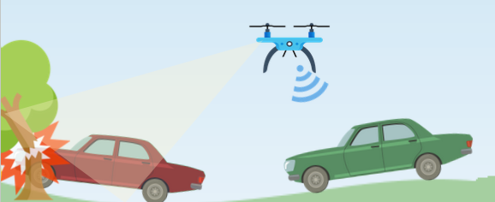
Introduction
With the rise of ADAS (Advanced Driver Assistance System) and autonomous vehicles, the need for a wide range of accurate, diverse, and timely use of sensors is growing.
UAVs can extend vision systems greatly by providing a wide aerial view.
However, drones are constrained by processing power, connection speed, and battery life.
We designed a testbed to test optimizations to drone-car collaborative models

Slide 3
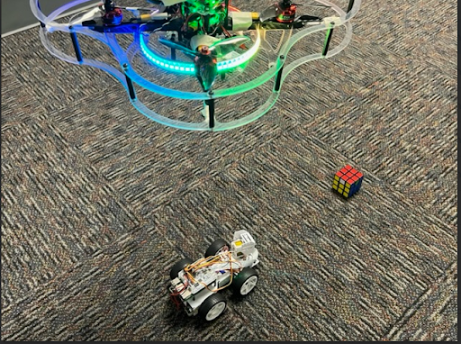
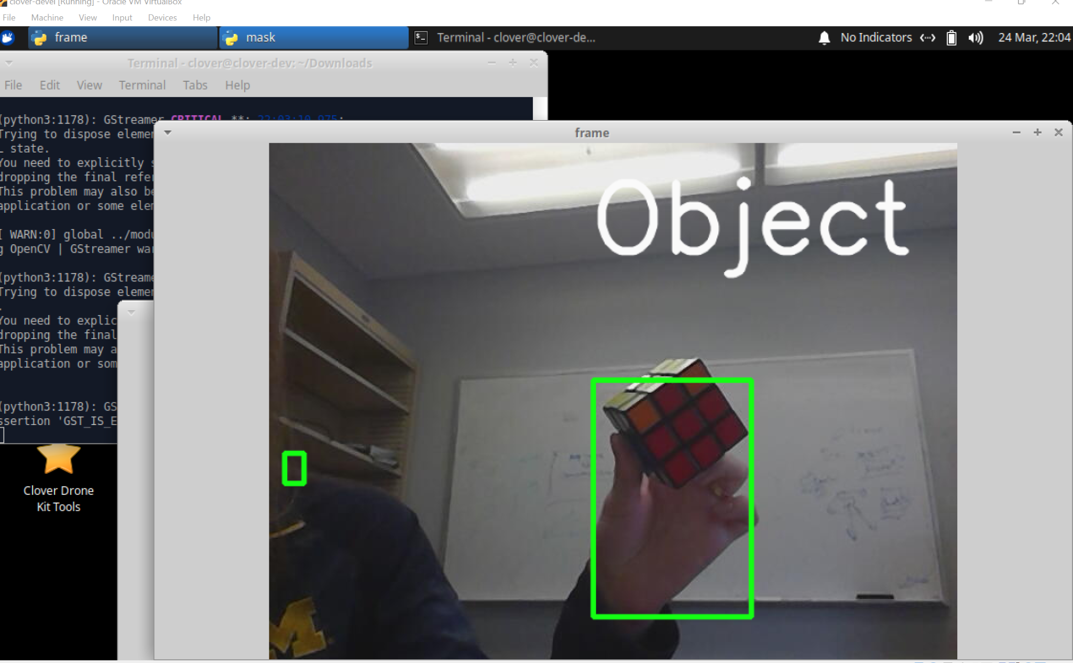
System Design and Implementation
Our experiment includes a Clover Drone and a PiCar.
As the car begins driving, the drone will automatically follow the car capturing video frames of the car’s surroundings.
We have created a program to analyze these video frames to detect a red object. Once a red object is detected, a command to stop will be sent to the car to execute.

Slide 4
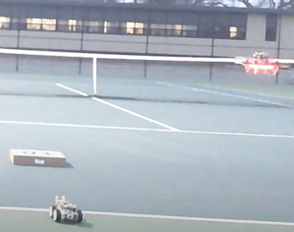
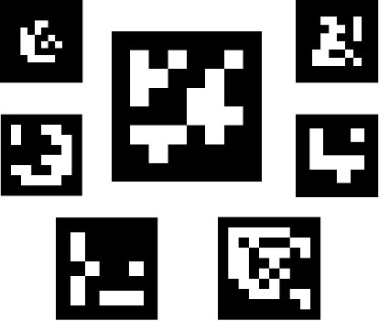
Future Work
Create a complex object detection system to identify different events.
Develop a video segmentation program that offsets time insensitive information for processing to the car (using machine learning).
Add functionality for the drone tracking and following the car’s position. Currently, we are using Aruco Markers for tracking the drone along a path with the car.

Slide 5
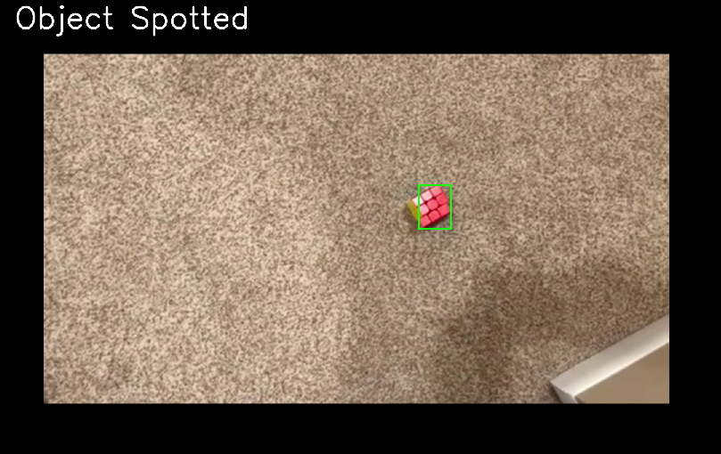
Conclusion
Developed an initial drone-car collaborative testbed.
Working on better object detection, video segmentation, and following the car
Will collect data on different approaches and determine the best optimizations to preserve drone battery life while processing time sensitive information

Slide 6
Contact Us
Demetrius Johnson
meech@umich.edu
Ryan Saur
sauerr@umich.edu
Jonathan Schall
jcschal@umich.edu
Olivia Pellegrini
opelle@umich.edu
Dr. Zheng Song
zhesong@umich.edu
Khairul Mottakin
khairulm@umich.edu

